Slide 1
Section 3.4
Library of Functions;
Piecewise-defined Functions
Copyright © 2012 Pearson Education, Inc. Publishing as Prentice Hall.

Slide 2
Copyright © 2012 Pearson Education, Inc. Publishing as Prentice Hall.

Slide 3
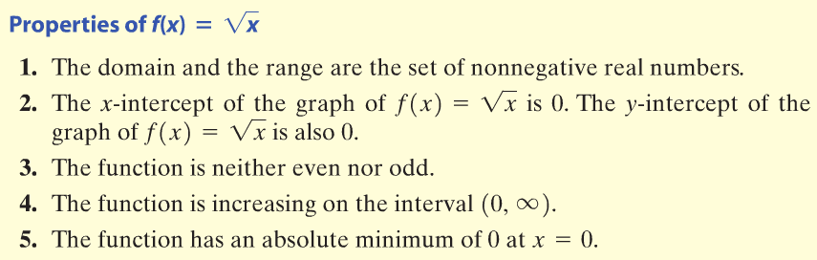
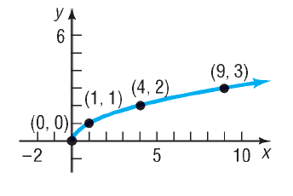
The Square Root Function
Copyright © 2012 Pearson Education, Inc. Publishing as Prentice Hall.

Slide 4

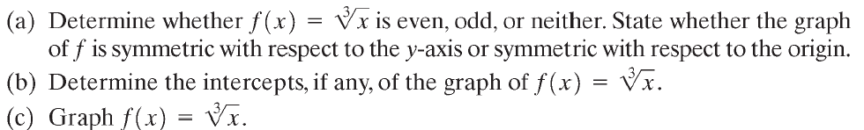
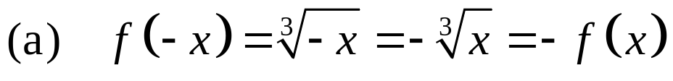
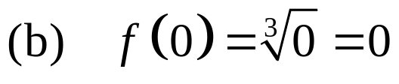
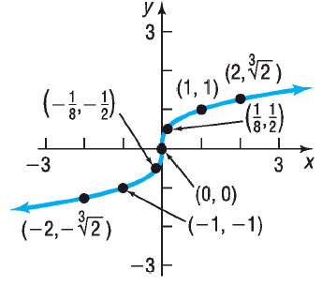
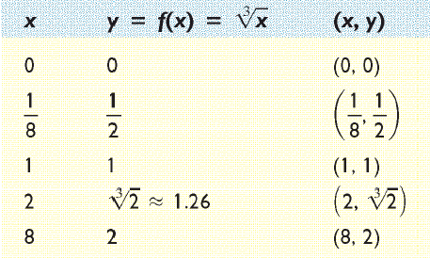
This means the function is odd and symmetric with respect to the origin.
x and y intercepts are both 0.
Copyright © 2012 Pearson Education, Inc. Publishing as Prentice Hall.

Slide 5
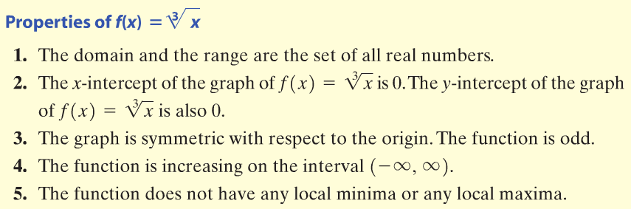
The Cube Root Function
Copyright © 2012 Pearson Education, Inc. Publishing as Prentice Hall.

Slide 6
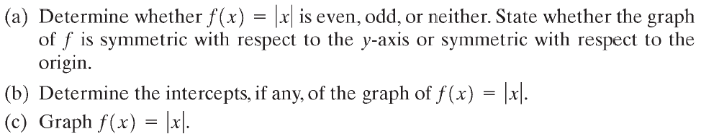
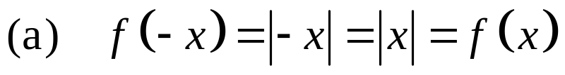
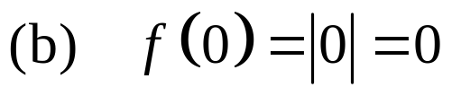
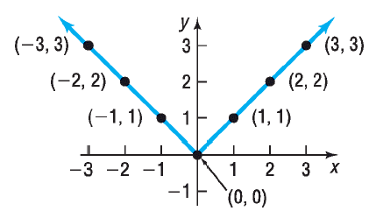
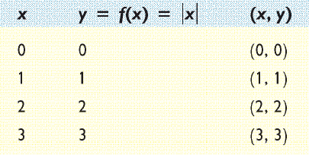
This means the function is even and symmetric with respect to the y-axis.
x and y intercepts are both 0.
Copyright © 2012 Pearson Education, Inc. Publishing as Prentice Hall.

Slide 7
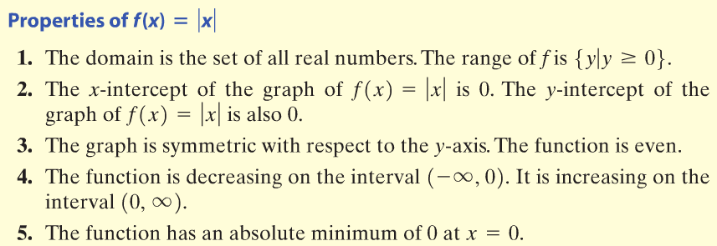
The Absolute Value Function
Copyright © 2012 Pearson Education, Inc. Publishing as Prentice Hall.

Slide 8


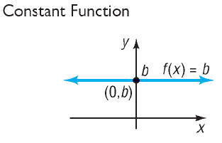
Copyright © 2012 Pearson Education, Inc. Publishing as Prentice Hall.

Slide 9


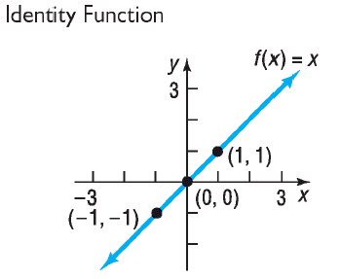
Copyright © 2012 Pearson Education, Inc. Publishing as Prentice Hall.

Slide 10


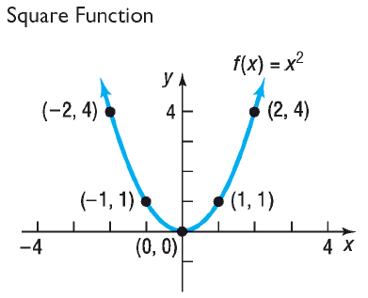
Copyright © 2012 Pearson Education, Inc. Publishing as Prentice Hall.

Slide 11


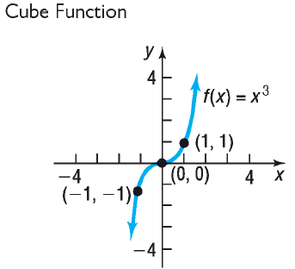
Copyright © 2012 Pearson Education, Inc. Publishing as Prentice Hall.

Slide 12


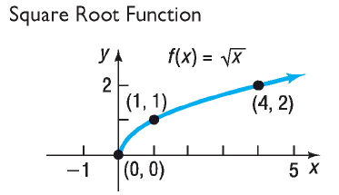
Copyright © 2012 Pearson Education, Inc. Publishing as Prentice Hall.

Slide 13


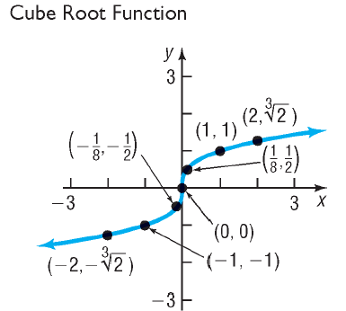
Copyright © 2012 Pearson Education, Inc. Publishing as Prentice Hall.

Slide 14

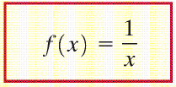
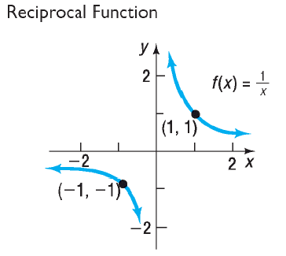
Copyright © 2012 Pearson Education, Inc. Publishing as Prentice Hall.

Slide 15


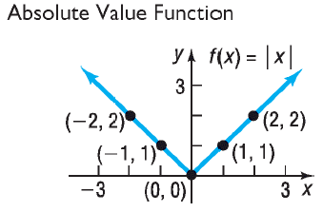
Copyright © 2012 Pearson Education, Inc. Publishing as Prentice Hall.

Slide 16


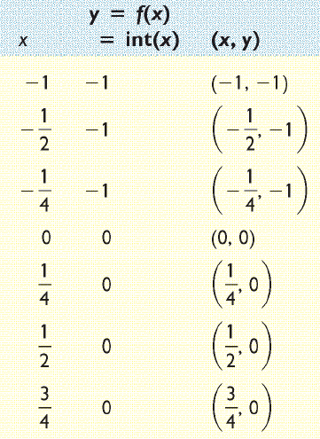
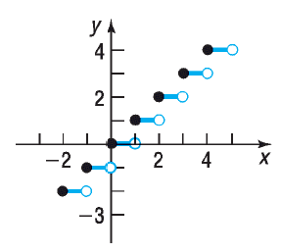
Copyright © 2012 Pearson Education, Inc. Publishing as Prentice Hall.

Slide 17

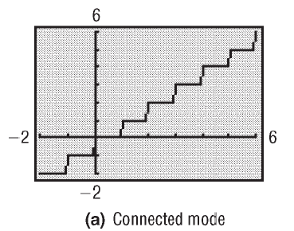
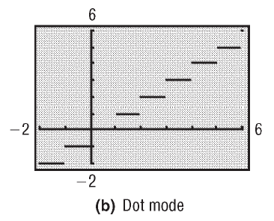
Copyright © 2012 Pearson Education, Inc. Publishing as Prentice Hall.

Slide 18

WISE
FUNCTIONS
Copyright © 2012 Pearson Education, Inc. Publishing as Prentice Hall.

Slide 19
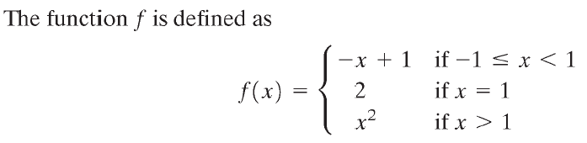
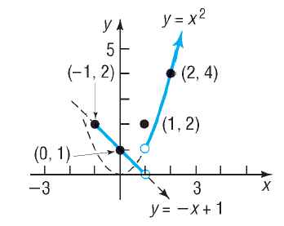
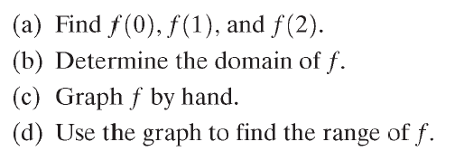
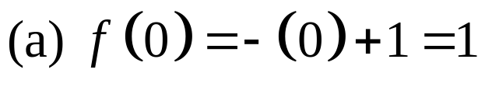
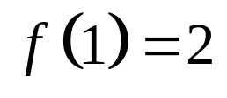
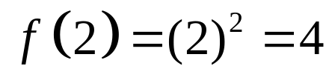


Copyright © 2012 Pearson Education, Inc. Publishing as Prentice Hall.

Slide 20
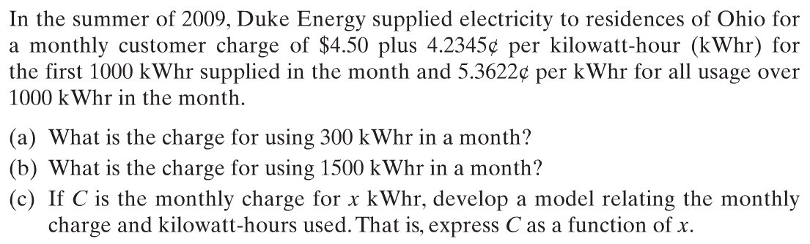
(a)
(b)
Copyright © 2012 Pearson Education, Inc. Publishing as Prentice Hall.

Slide 21
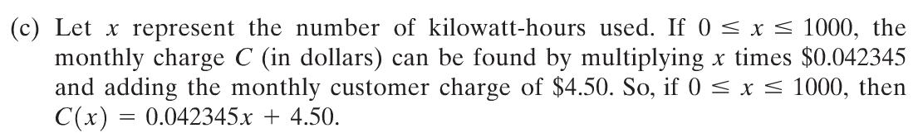
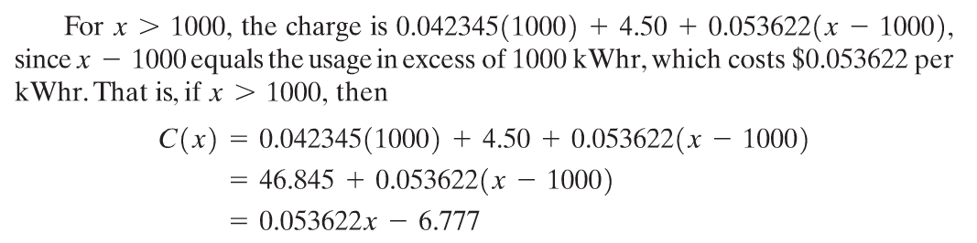
Copyright © 2012 Pearson Education, Inc. Publishing as Prentice Hall.

Slide 22

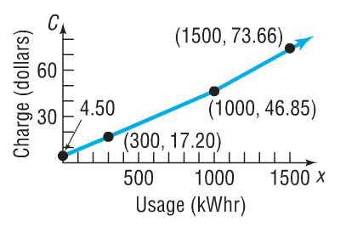
Copyright © 2012 Pearson Education, Inc. Publishing as Prentice Hall.

